Slide 1
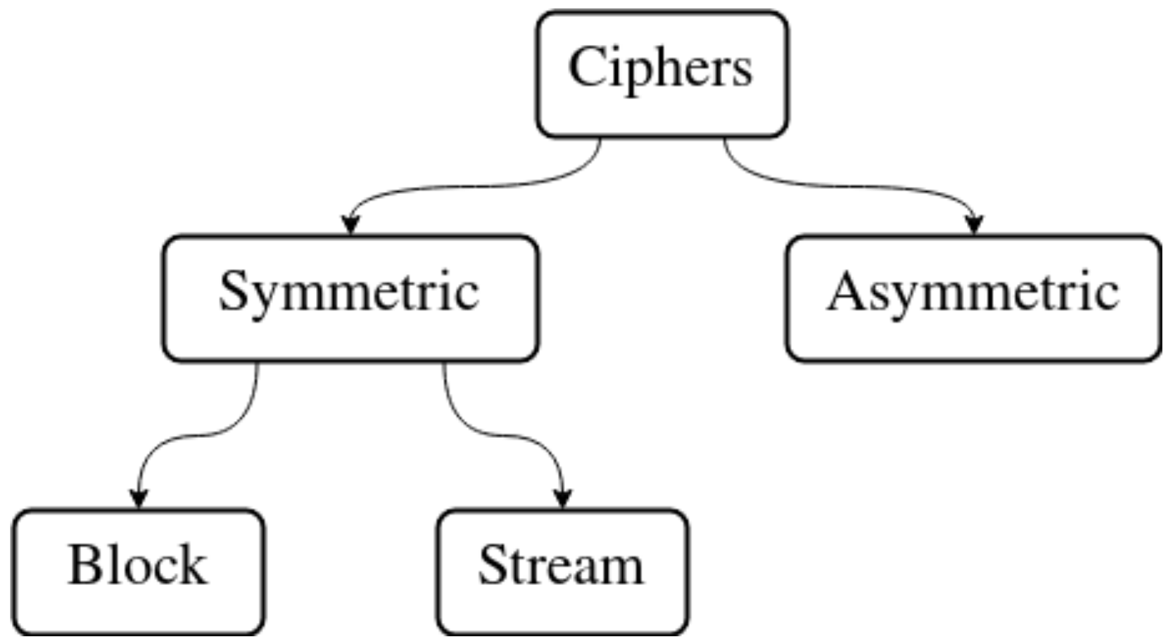
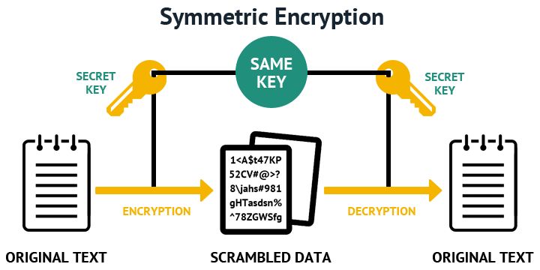
Information Security
Lecture 4
Contemporary Symmetric Ciphers
Dr. Muazzam Ali Khan Khattak
Professor
Department of Computer Science
QAU, Islamabad
Email: muazzam.khattak@qau.edu.pk

Slide 2
Multiple Encryption & DES
Multiple encryption is a technique in which an encryption algorithm is used multiple times.
Replacement for DES was needed
  Theoretical attacks that can break it
  Exhaustive key search attacks/Brute Force
Use of multiple encryption with DES in 2 & 3-DES
AES is new cipher Algorithm
Notes:
Given the potential vulnerability of DES to a brute-force attack,there has been considerable interest in finding an alternative. One approach is to design a completely new algorithm, of which AES is a prime example. Another alternative, which would preserve the existing investment in software and equipment, is to use multiple encryption with DES and multiple keys. We examine the widely accepted triple DES (3DES) approach.

Slide 3

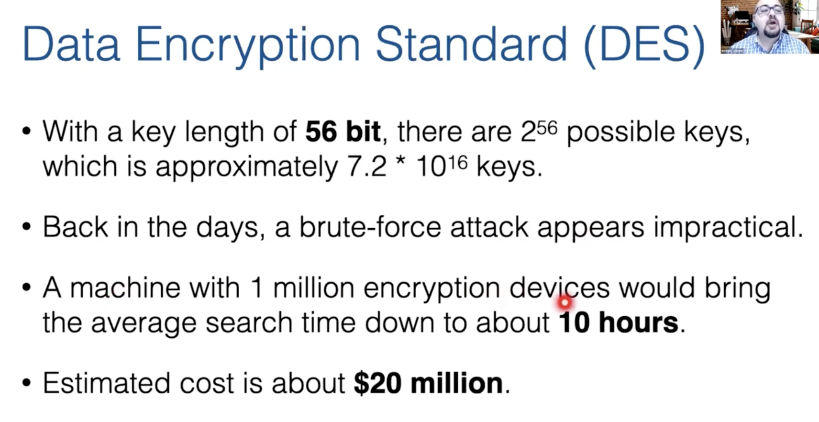
Data Encryption Standard (DES)

Slide 4
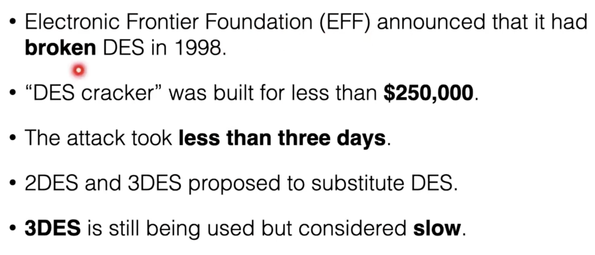
Data Encryption Standard (DES)

Slide 5
2-DES / Double-DES
Use of 2 DES encrypts on each block
  C = E_{K2}(E_{K1}(P))
Issue of reduction to single stage
Have “meet-in-the-middle” attack
  Since X = E_{K1}(P) = D_{K2}(C)
  Attack by encrypting P with all keys and store
  Decrypt C with keys and match X value
  It takes O(2⁵⁶) steps
Notes:
The simplest form of multiple encryption has two encryption stages and two keys - Double-DES.
Have concern that there might be a single key that is equivalent to using 2 keys as above, not likely but only finally proved in 1992.
More seriously have the “meet-in-the-middle” attack, first described by Diffie in 1977. It is a known plaintext attack (ie have know pair (P,C), and attempts to find by trial-and-error a value X in the “middle” of the double-DES encryption of this pair, and chances of this are much better at O(2^56) than exhaustive search at O(2^112).

Slide 6
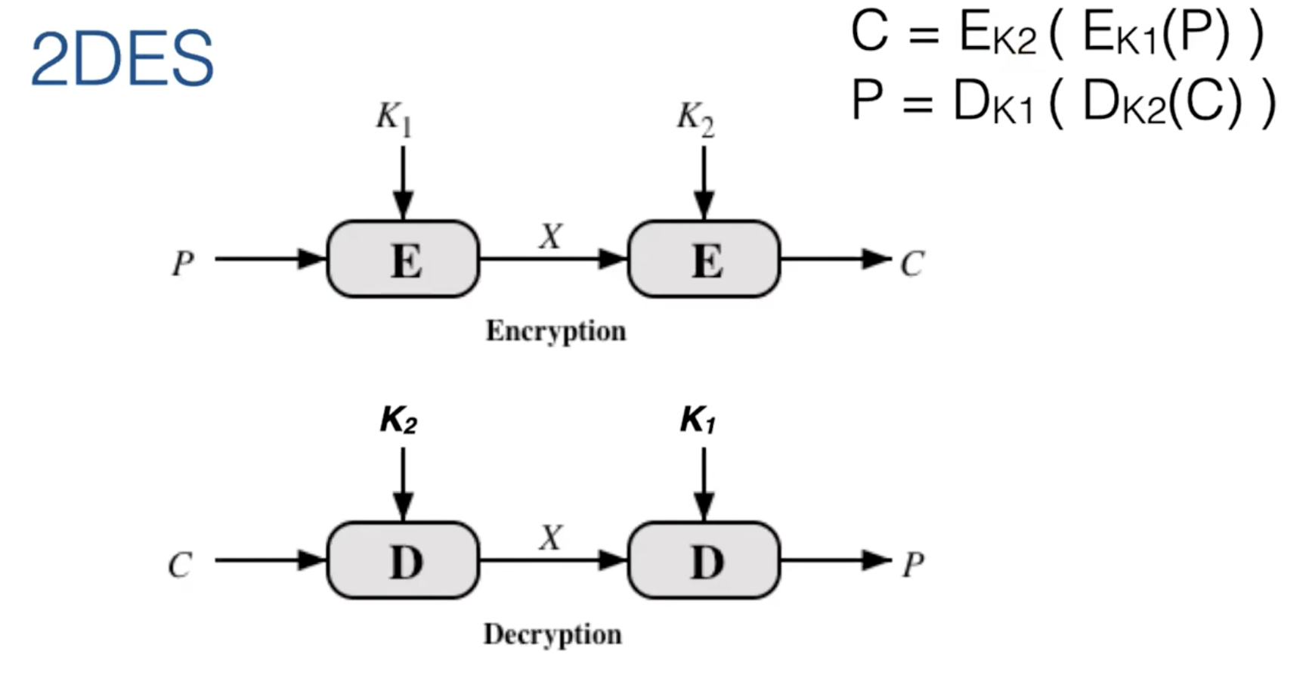
2-DES
https://www.youtube.com/watch?v=IZFaZDO3-GQ

Slide 7
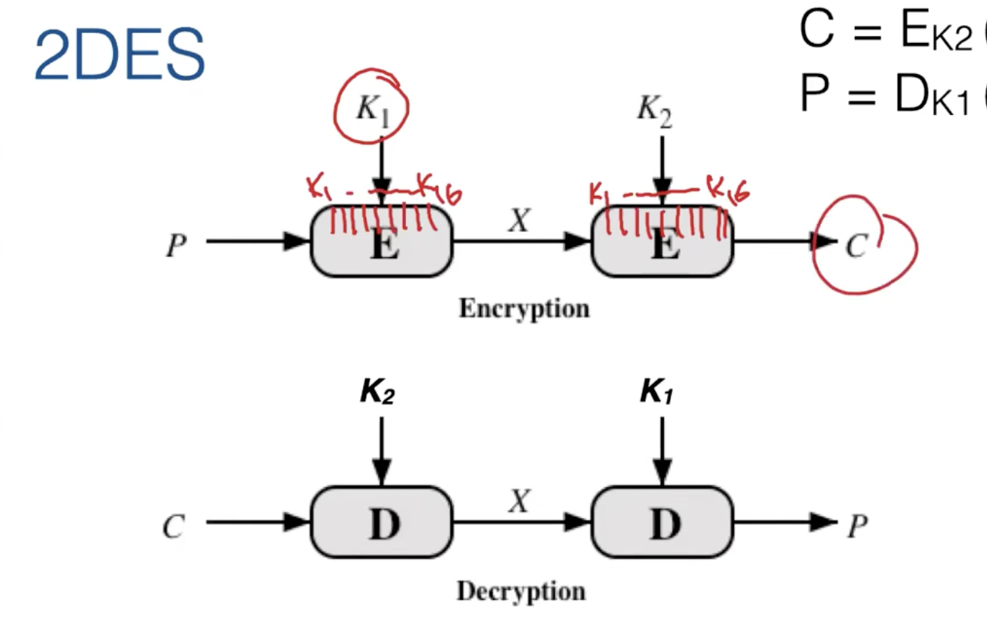
2-DES

Slide 8
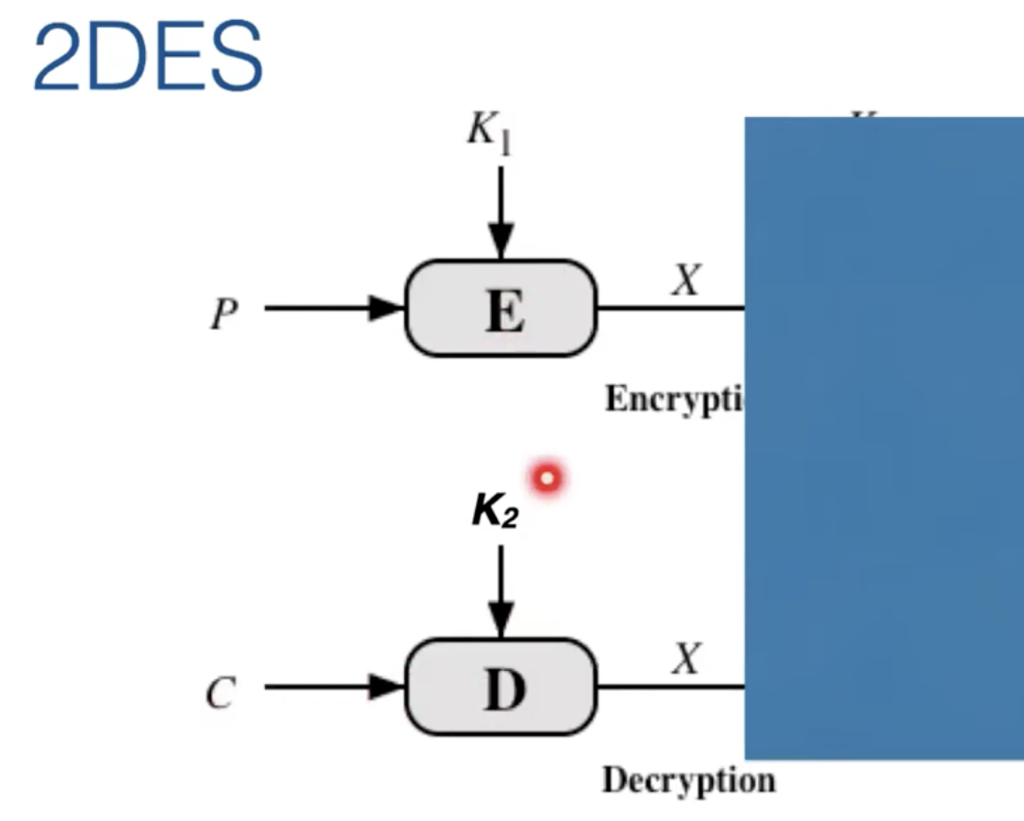
Meet in The Middle Attack

Slide 9
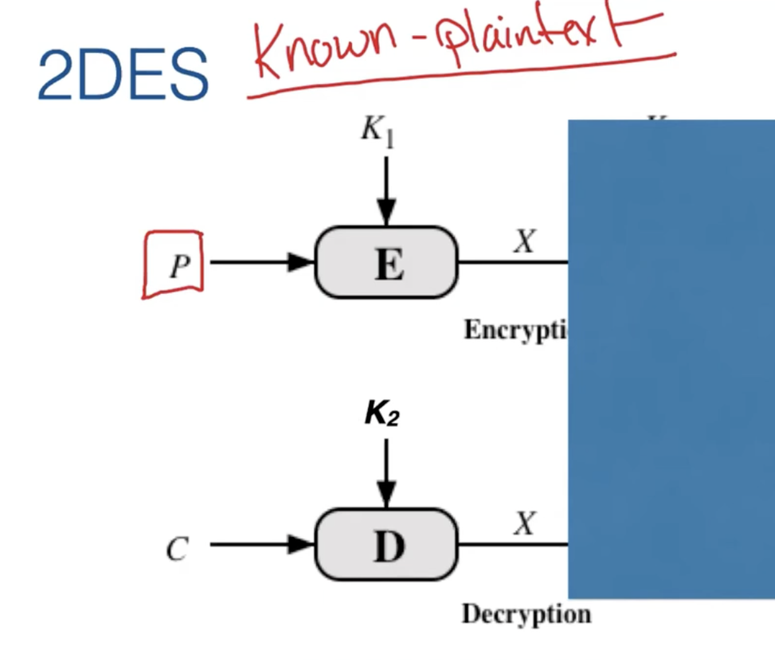
Known Plain Text Attack
https://www.youtube.com/watch?v=4R_kocR1roM&t=503s

Slide 10
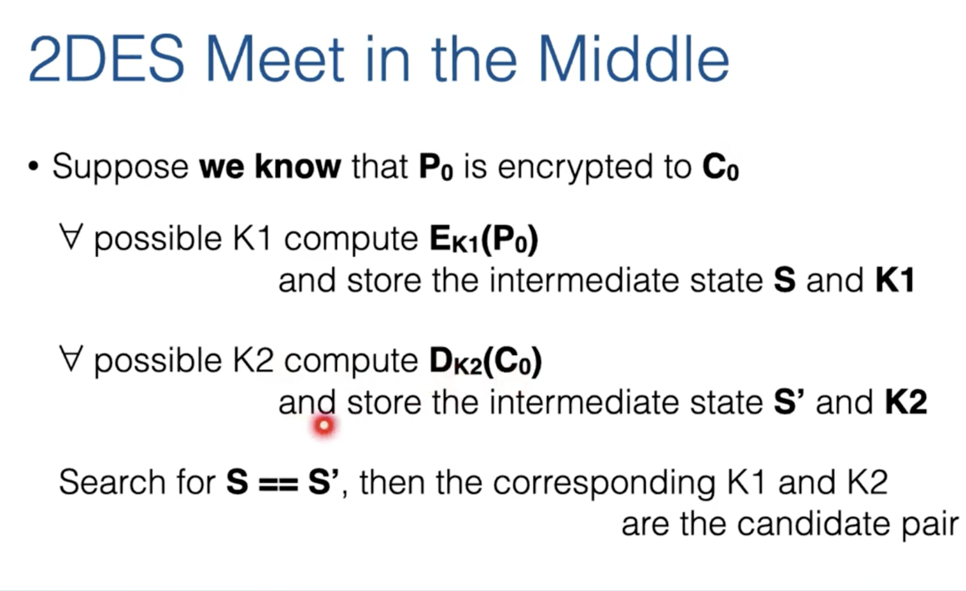

Slide 11
Triple-DES
Uses 03 Steps
  Seem to need 03 distinct keys
But 3DES uses 02 keys with E-D-E sequence
  C = E_{K1}(D_{K2}(E_{K1}(P)))
  if K1=K2 then can work with single DES
No current known practical attacks on two-key 3DES
Use of Triple-DES with 3-keys to enhance the security
  C = E_{K3}(D_{K2}(E_{K1}(P)))
https://www.youtube.com/watch?v=23JangqRhIc
Notes:
Triple-DES with two keys is a popular alternative to single-DES, but suffers from being 3 times slower to run. The use of encryption & decryption stages are equivalent, but the chosen structure allows for compatibility with single-DES implementations. 3DES with two keys is a relatively popular alternative to DES and has been adopted for use in the key management standards ANS X9.17 and ISO 8732. Currently, there are no practical cryptanalytic attacks on 3DES. Coppersmith notes that the cost of a brute-force key search on 3DES is on the order of 2^112 (=5*10^33) and estimates that the cost of differential cryptanalysis suffers an exponential growth, compared to single DES, exceeding 10^52.

Slide 12
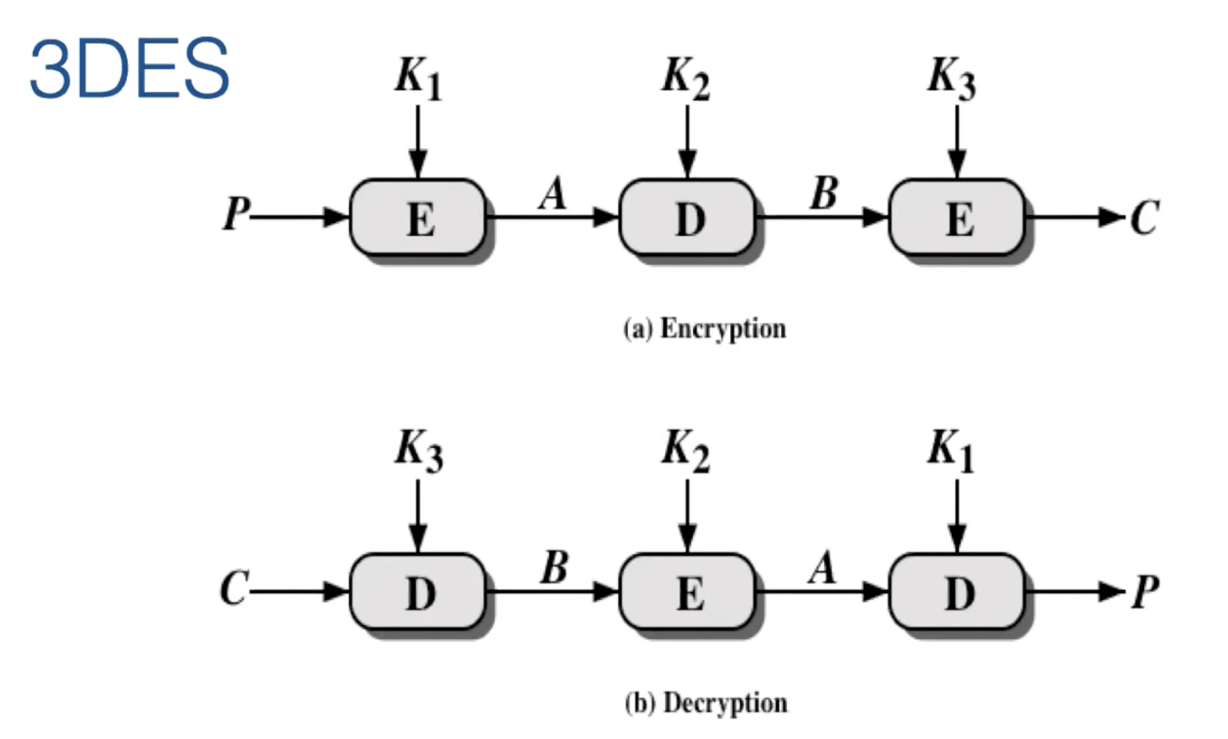
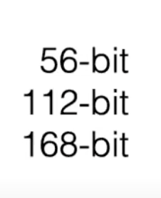

Slide 13
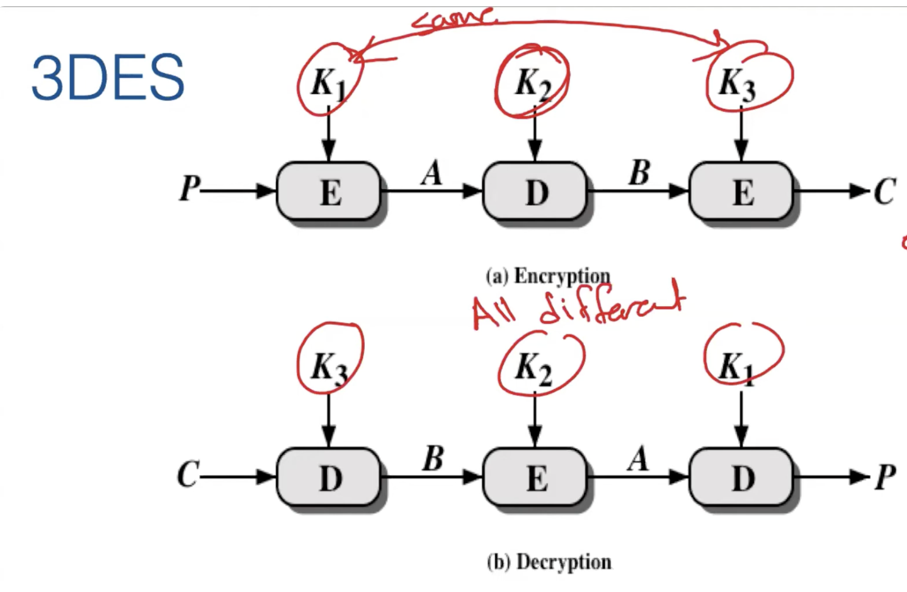
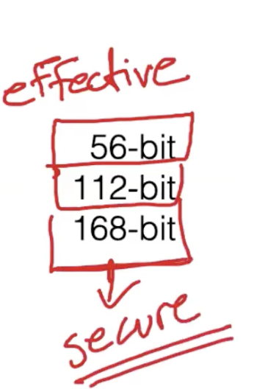
IF ALL Keys are Same Effective Key Size is 56, If K1 and K3 are Same But K2 is Different Effective Key Size is 112. If All Keys are Different Effective Size ll be 168.

Slide 14
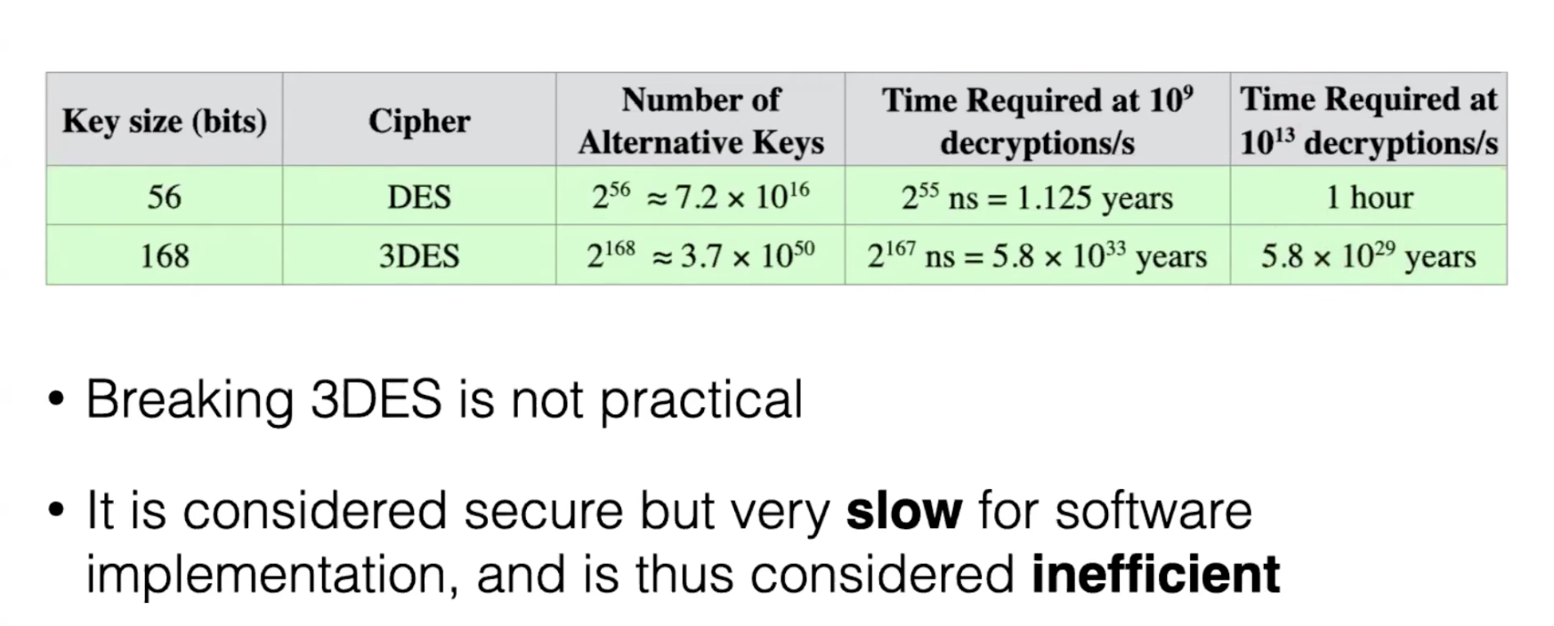

Slide 15
DES Modes of Operation
Subsequently 5 defined for AES & DES
Have block and stream modes
  Electronic Codebook (ECB)
  Cipher Block Chaining (CBC)
  Counter (CTR)
  Cipher Feedback (CFB)
  Output Feedback (OFB)
  https://www.youtube.com/watch?v=BE1cskZUkrs
Notes:
DES (or any block cipher) forms a basic building block, which en/decrypts a fixed sized block of data. However to use these in practise, we usually need to handle arbitrary amounts of data, which may be available in advance (in which case a block mode is appropriate), and may only be available a bit/byte at a time (in which case a stream mode is used). To apply a block cipher in a variety of applications, four “modes of operation” have been defined by NIST (FIPS 81). The four modes are intended to cover virtually all the possible applications of encryption for which a block cipher could be used. As new applications and requirements have appeared, NIST has expanded the list of recommended modes to five in Special Publication 800-38A. These modes are intended for use with any symmetric block cipher, including triple DES and AES.

Slide 16
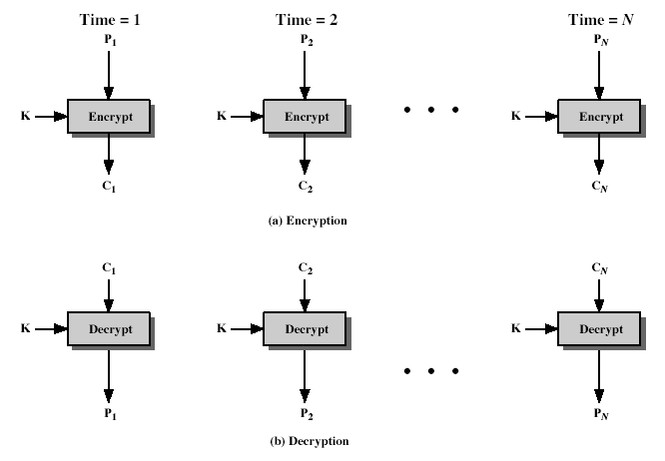
1. Electronic Codebook (ECB)
Message is broken into independent blocks
Each block is like a codebook
Each block is encoded independently of the other blocks i.e. C_{i} = DES_{K1}(P_{i})
Uses: secure transmission of single values
Notes:
The simplest mode is the electronic codebook (ECB) mode, in which plaintext is handled one block at a time and each block of plaintext is encrypted using the same key. ECB is the simplest of the modes, and is used when only a single block of info needs to be sent (eg. a session key encrypted using a master key).

Slide 17
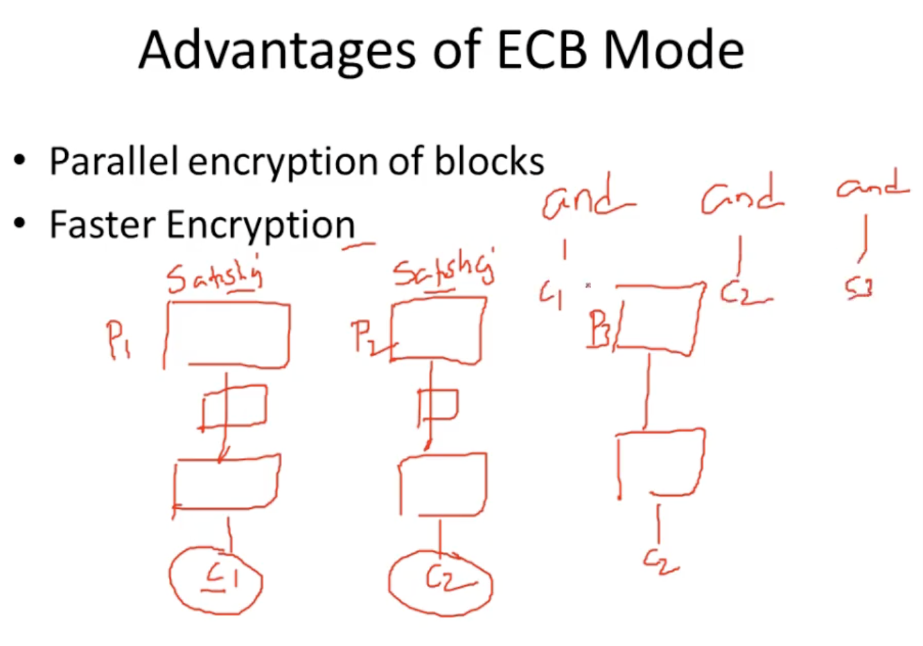
Not Recommended for long messages having repeated messages
Secure Transmission of Single Block or Values

Slide 18
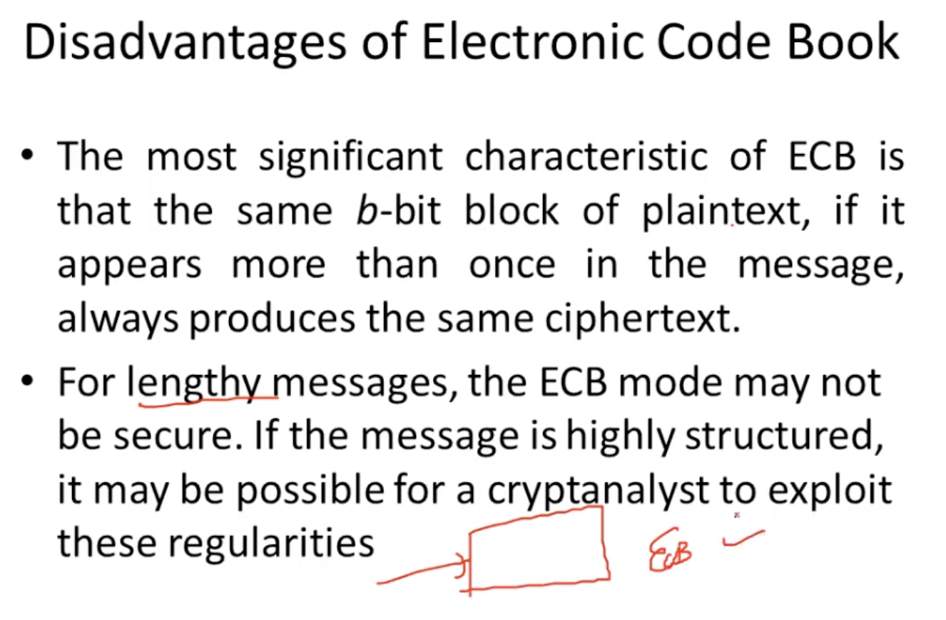

Slide 19
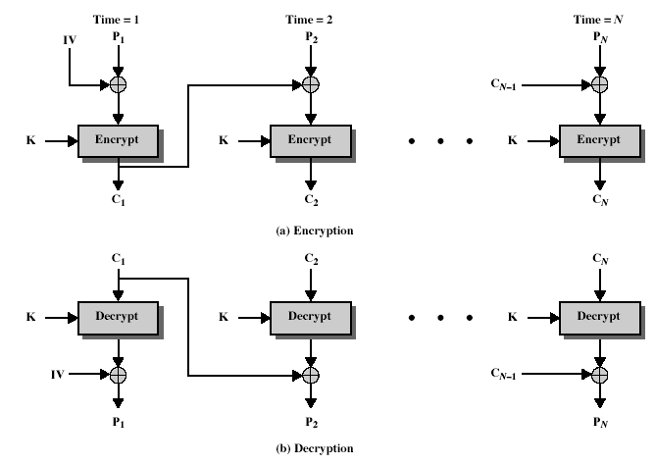
2. Cipher Block Chaining (CBC)
Message is broken into blocks
Previous cipher block is chained with current plaintext block
Uses Initial Vector (IV) to start process
  C_{i} = DES_{K1}(P_{i} XOR C_{i-1}) & C₋₁ = IV
Uses: bulk data encryption, authentication
Notes:
To overcome the problems of repetitions and order independence in ECB, want some way of making the ciphertext dependent on all blocks before it. This is what CBC gives us, by combining the previous ciphertext block with the current message block before encrypting. To start the process, use an Initial Value (IV), which is usually well known (often all 0's), or otherwise is sent, ECB encrypted, just before starting CBC use. CBC mode is applicable whenever large amounts of data need to be sent securely, provided that all data is available in advance (eg email, FTP, web etc).

Slide 20
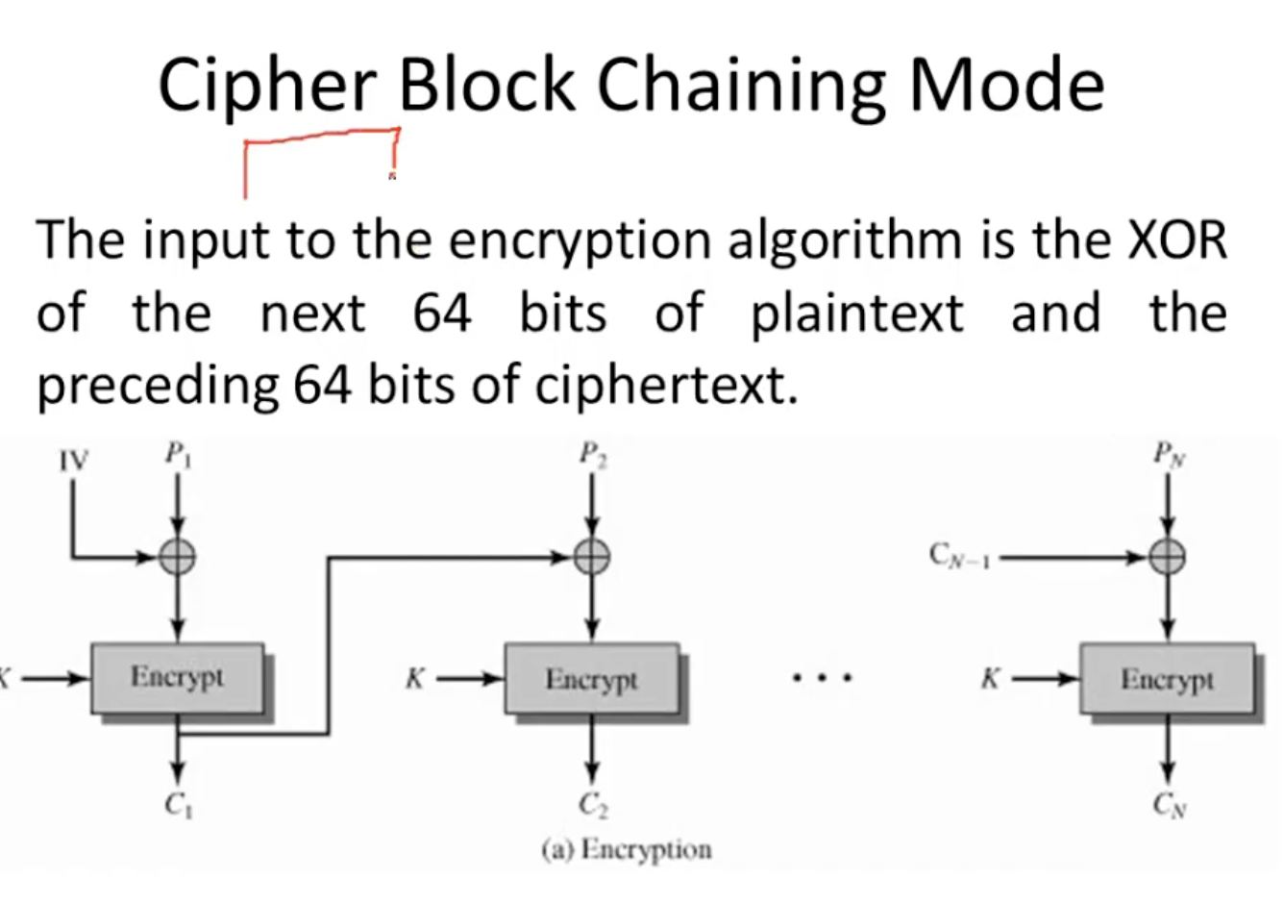

Slide 21
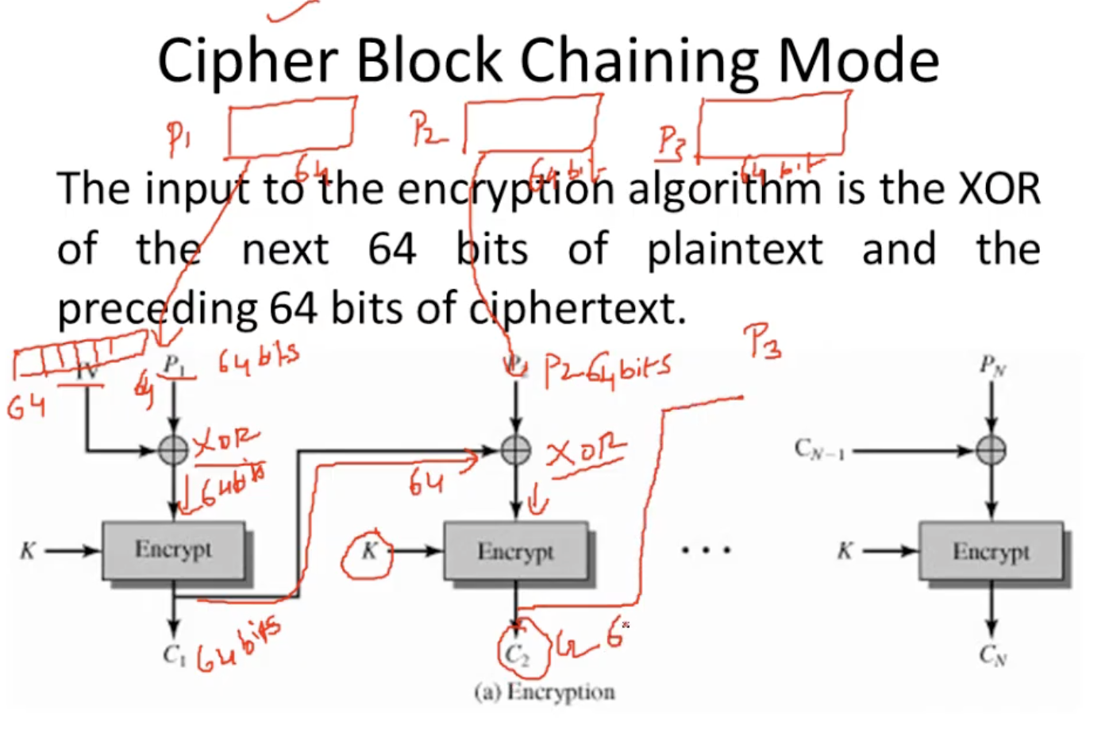

Slide 22
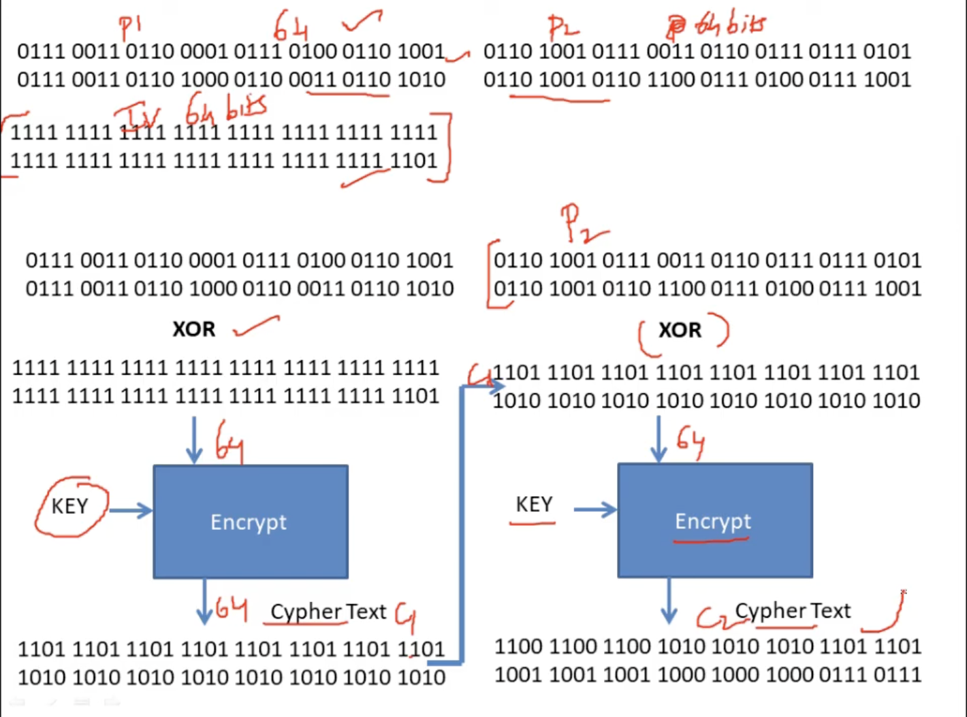
Example CBC

Slide 23
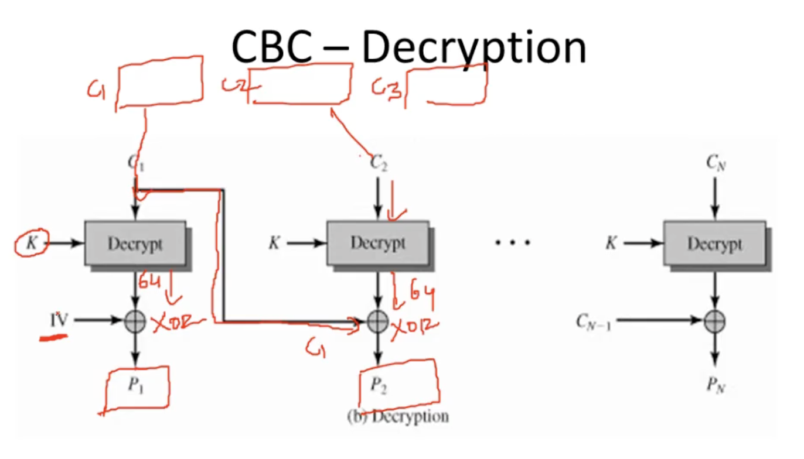
Decryption

Slide 24
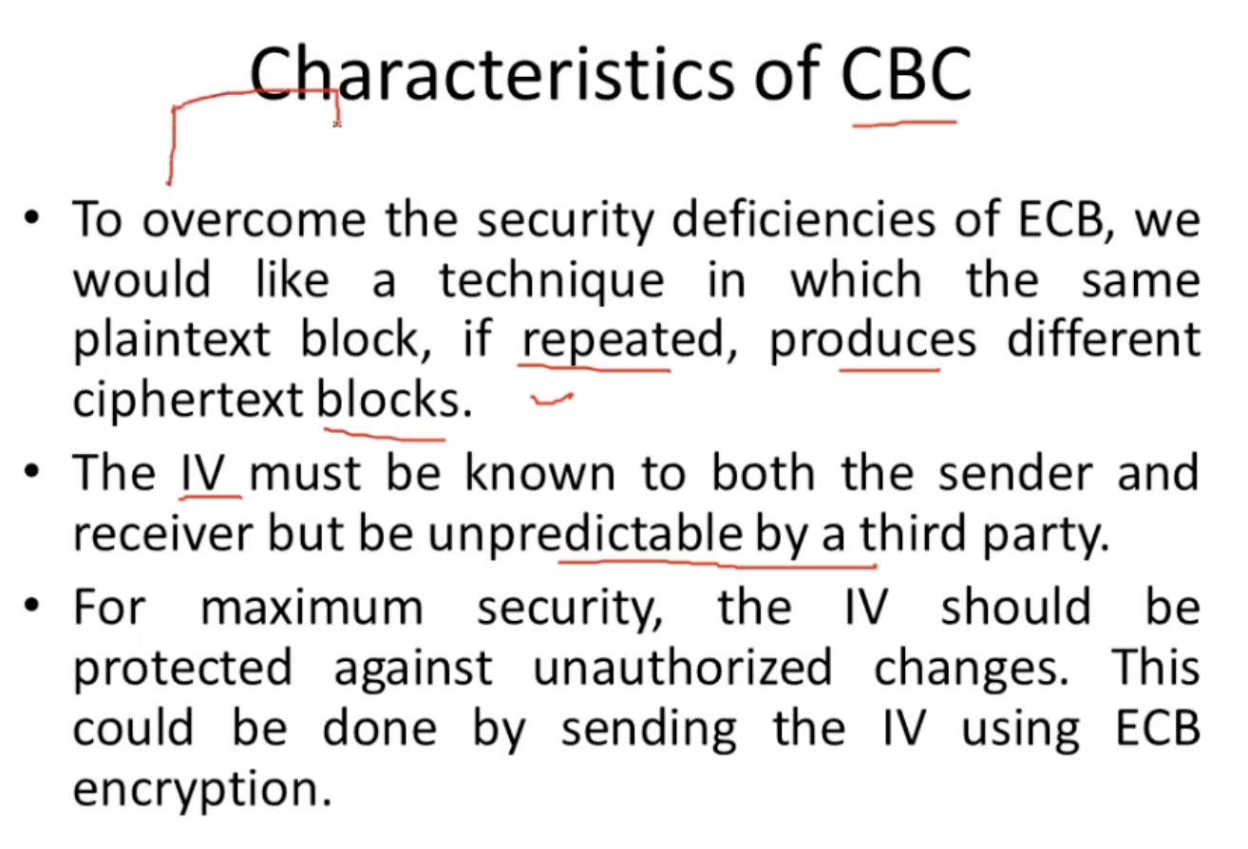

Slide 25
Advantages & Limitations of CBC
Ciphertext block depends on all blocks before it
Any change to a block affects all following ciphertext blocks
Parallel Encryption is Not Possible like ECB
Initialization Vector (IV)
  which must be known to sender & receiver
  IV must be sent encrypted.
  if sent in clear, attacker can change IV to compensate
Notes:
CBC is the block mode generally used. The chaining provides an avalanche effect, which means the encrypted message cannot be changed or rearranged without totally destroying the subsequent data. However there is the issue of ensuring that the IV is either fixed or sent encrypted in ECB mode to stop attacks on 1st block.

Slide 26
3. Counter (CTR)
New mode, though proposed earlier
Similar to OFB but encrypts counter value rather than any feedback value
Must have a different key & counter value for every plaintext block (never reused)
  C_{i} = P_{i} XOR O_{i}
  O_{i} = DES_{K1}(i)
Uses: high-speed network encryptions
Notes:
The Counter (CTR) mode is a variant of OFB, but which encrypts a counter value (hence name). Although it was proposed many years before, it has only recently been standardized for use with AES along with the other existing 4 modes. It is being used with applications in ATM (asynchronous transfer mode) network security and IPSec (IP security). A counter, equal to the plaintext block size is used. The only requirement stated in SP 800-38A is that the counter value must be different for each plaintext block that is encrypted. Typically the counter is initialized to some value and then incremented by 1 for each subsequent block.

Slide 27
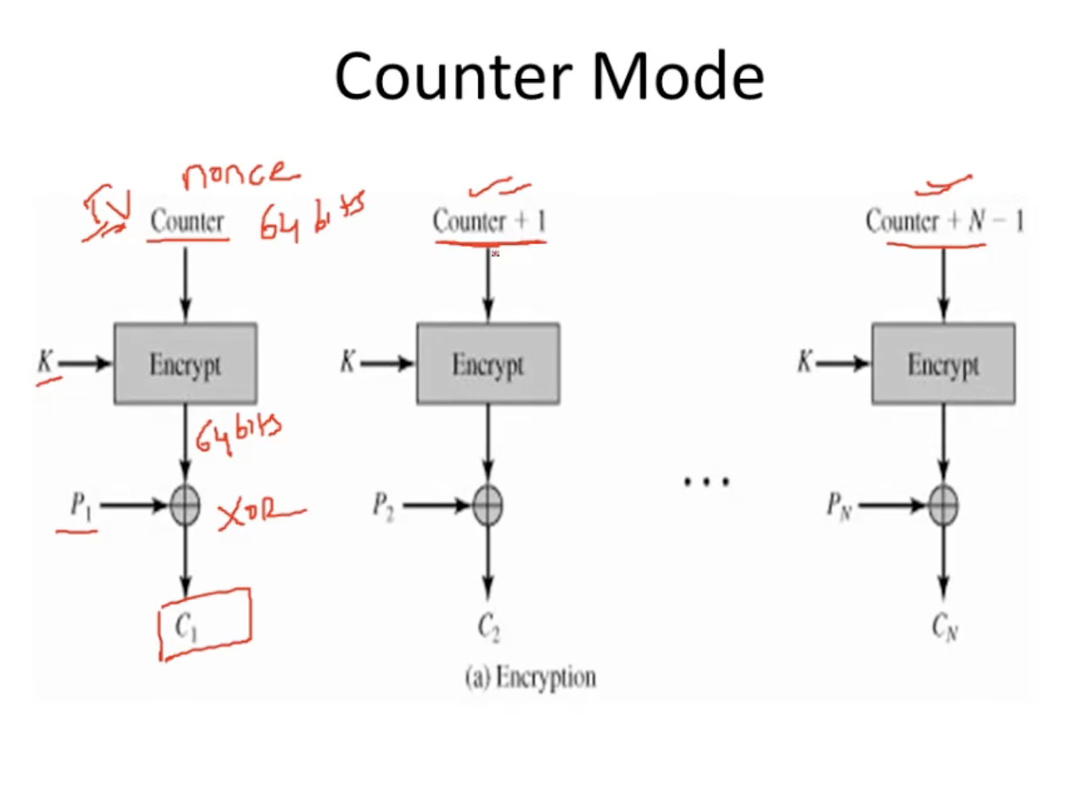

Slide 28
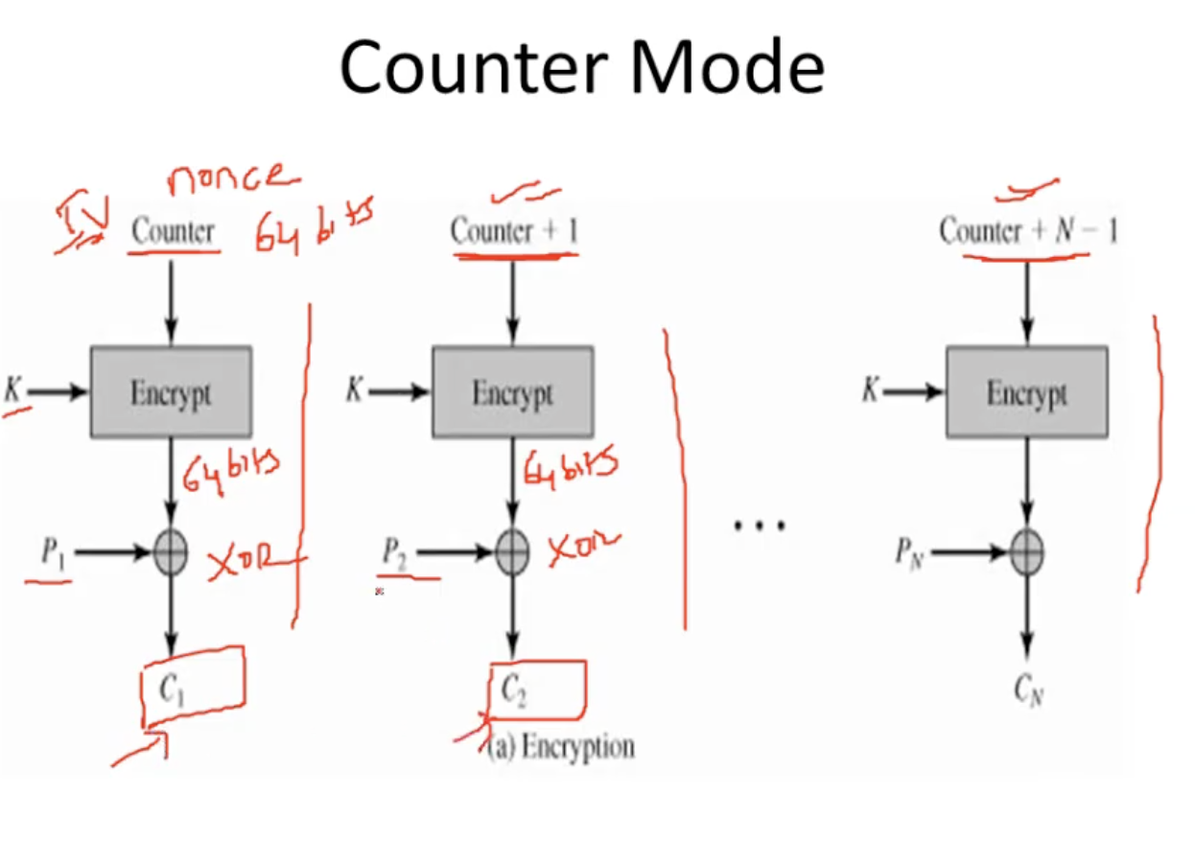
Parallel Encryption and Different Cipher obtain even for same Plaintext

Slide 29
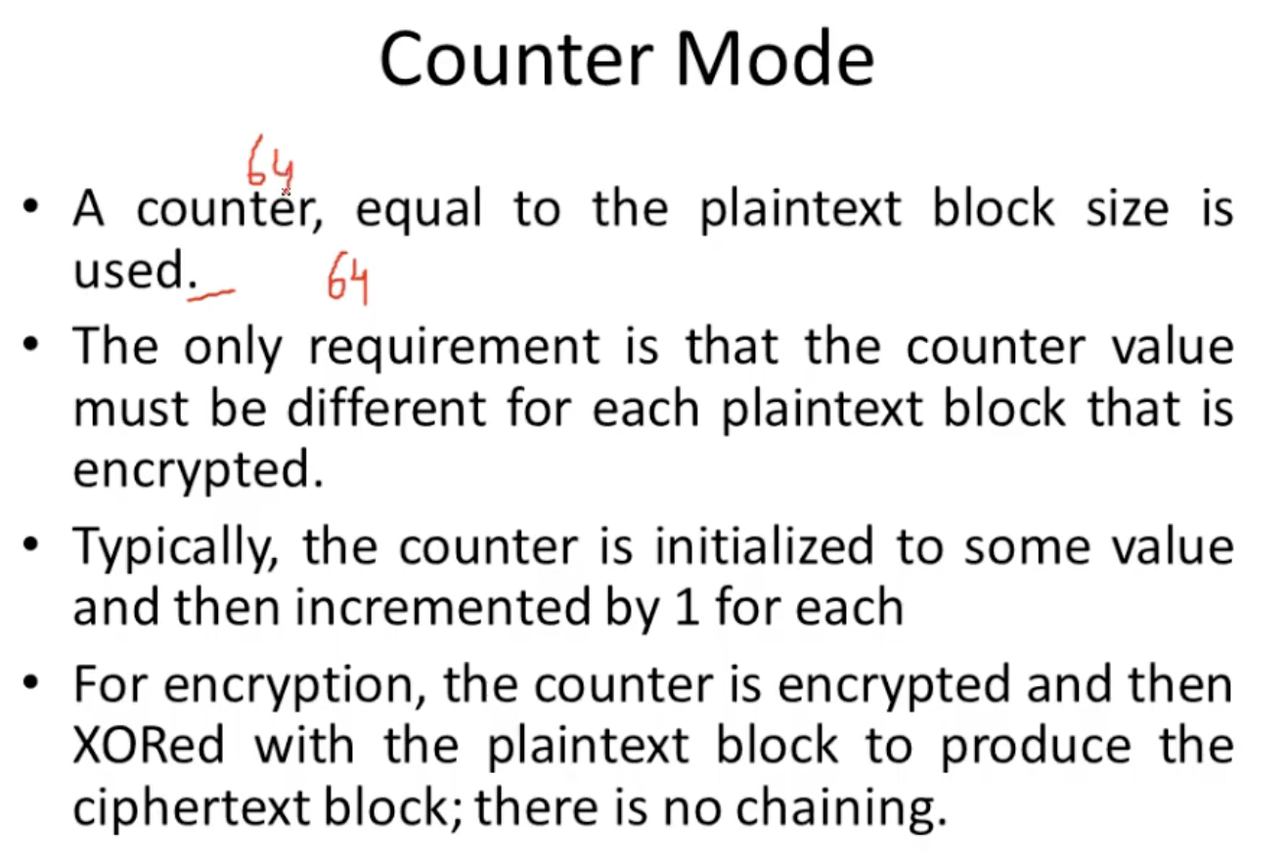

Slide 30
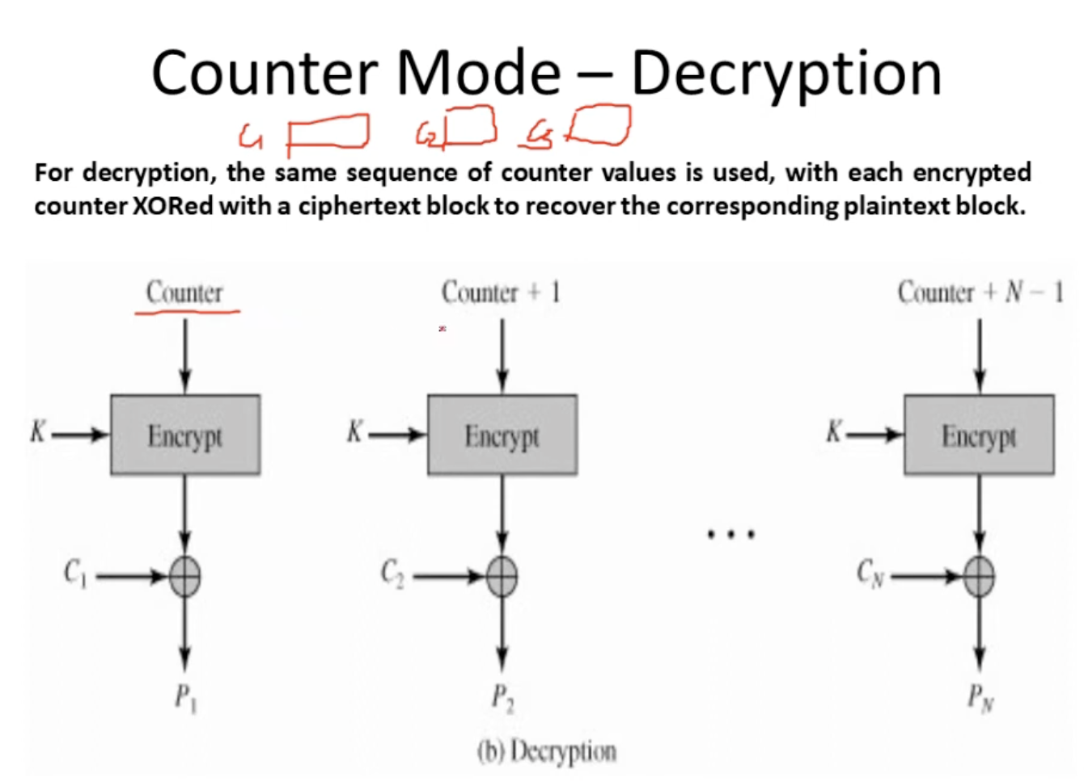
Decryption

Slide 31
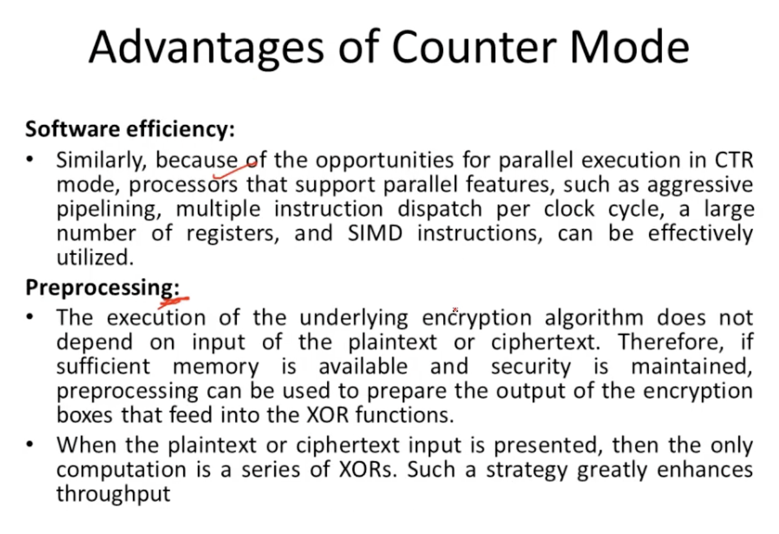
Single input Multiple Data

Slide 32
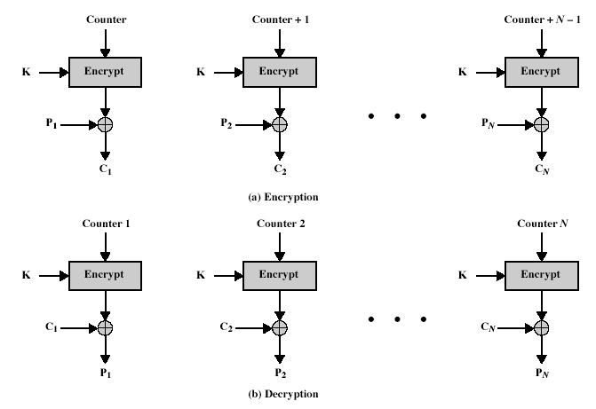
Counter (CTR)
Notes:
Stallings Figure 6.7 illustrates the Counter (CTR) Mode.

Slide 33
Advantages and Limitations of CTR
Efficiency
  can do parallel encryptions in h/w or s/w
  can preprocess in advance of need
  good for bursty high speed links
Random access to encrypted data blocks
Provable security (good as other modes)
But must ensure never reuse key/counter values, otherwise could break (cf OFB)
Notes:
CTR mode has a number of advantages in parallel h/w & s/w efficiency, can preprocess the output values in advance of needing to encrypt, can get random access to encrypted data blocks, and is simple. But like OFB have issue of not reusing the same key+counter value.

Slide 34
4. Cipher Feedback (CFB)
Message is treated as a stream of bits
Added to the output of the block cipher
Result is feed back for next stage
Standard allows any number of bit (1,8, 64 or 128 etc) to be feed back
  denoted CFB-1, CFB-8, CFB-64, CFB-128 etc
Most efficient to use all bits in block (64 or 128)
  C_{i} = P_{i} XOR DES_{K1}(C_{i-1})
  C₋₁ = IV
Uses: stream data encryption
Notes:
If the data is only available a bit/byte at a time (eg. terminal session, sensor value etc), then must use some other approach to encrypting it, so as not to delay the info. Idea here is to use the block cipher essentially as a pseudo-random number generator (see stream cipher lecture later) and to combine these "random" bits with the message. Note as mentioned before, XOR is an easily inverted operator (just XOR with same thing again to undo). Again start with an IV to get things going, then use the ciphertext as the next input. As originally defined, idea was to "consume" as much of the "random" output as needed for each message unit (bit/byte) before "bumping" bits out of the buffer and re-encrypting. This is wasteful though, and slows the encryption down as more encryptions are needed. An alternate way to think of it is to generate a block of "random" bits, consume them as message bits/bytes arrive, and when they're used up, only then feed a full block of ciphertext back. This is CFB-64 or CFB-128 mode (depending on the block size of the cipher used eg DES or AES respectively). CFB is the usual choice for quantities of stream oriented data, and for authentication use.

Slide 35
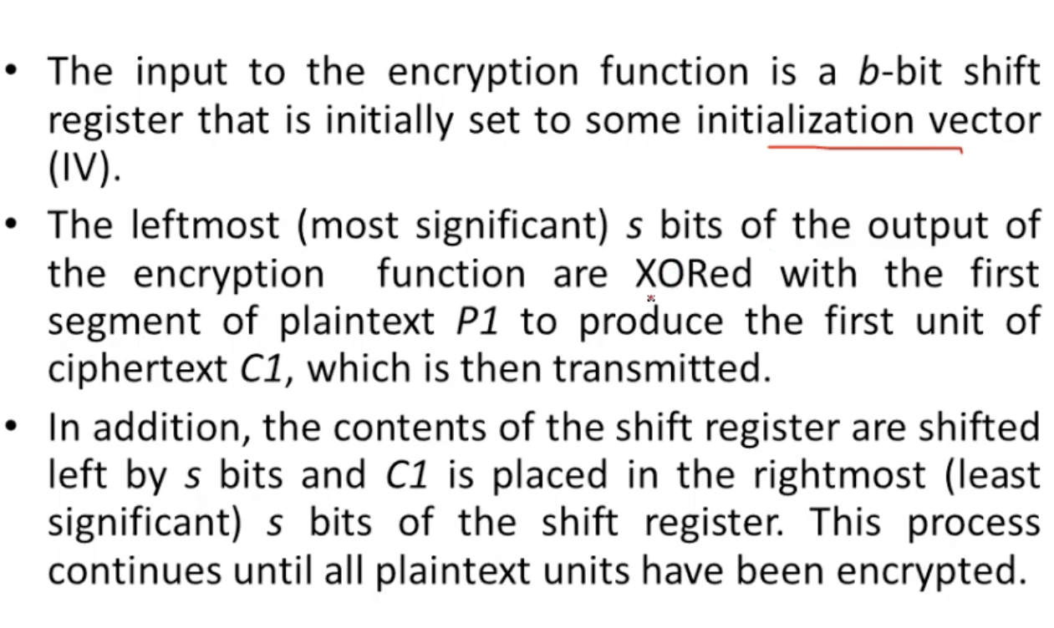
Cipher Feedback (CFB)

Slide 36
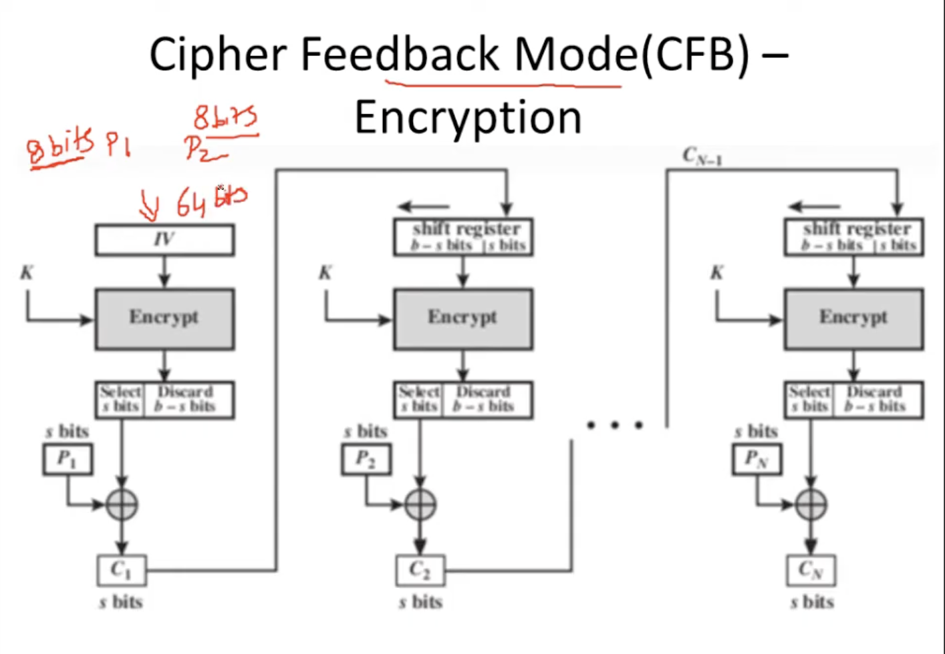
Use Streams of 8 Bits and 64 Bits IV (Initialization Vector)

Slide 37
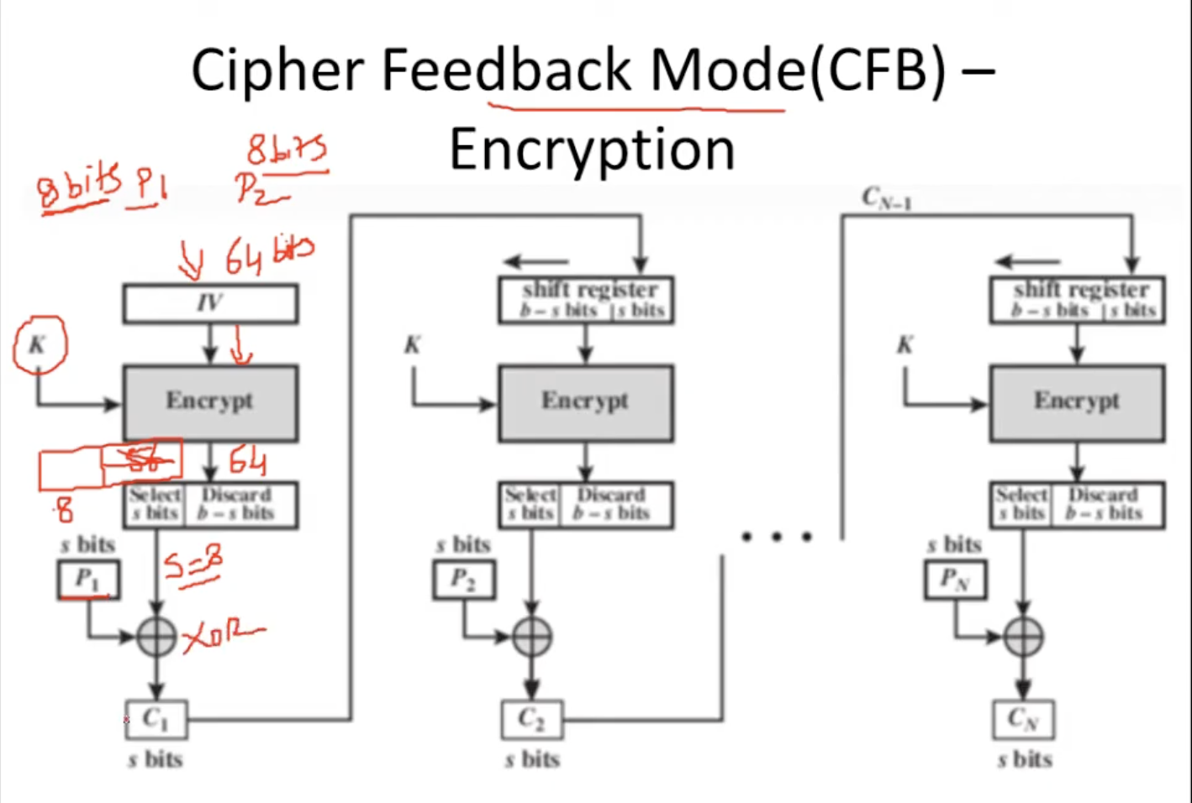
After Encryption Take the 8 left Bits as P1 is 8 Bits & Discard 56 Bits.

Slide 38
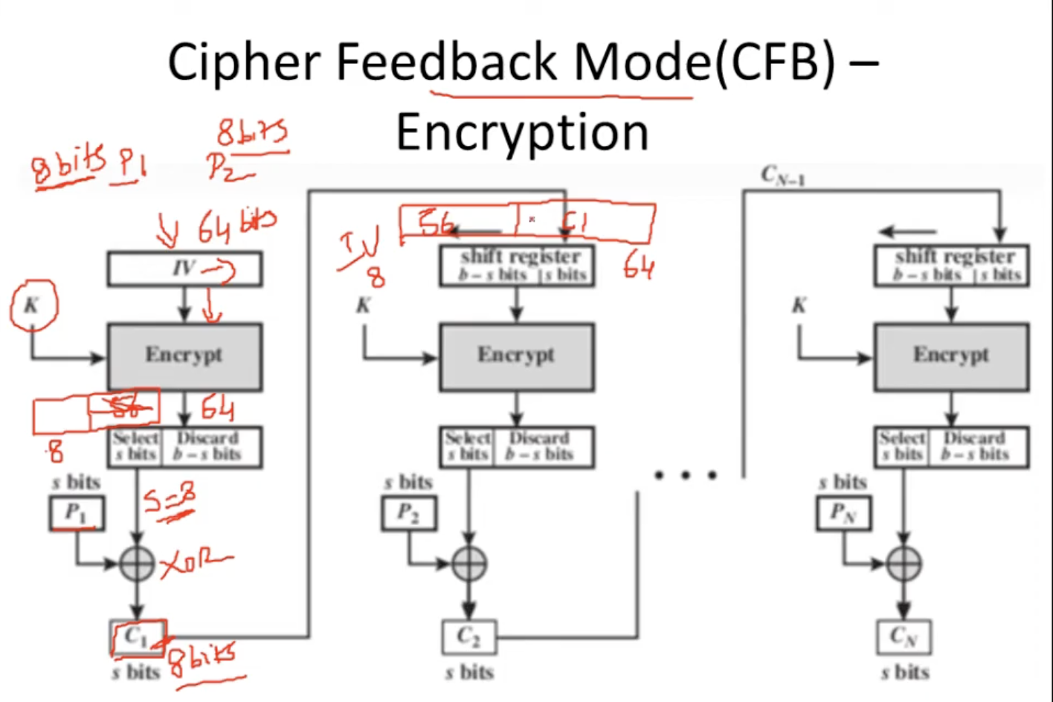
Step 2 ll start with Left Shift of IV and C1 ll be Place on The Right Side of the IV.

Slide 39
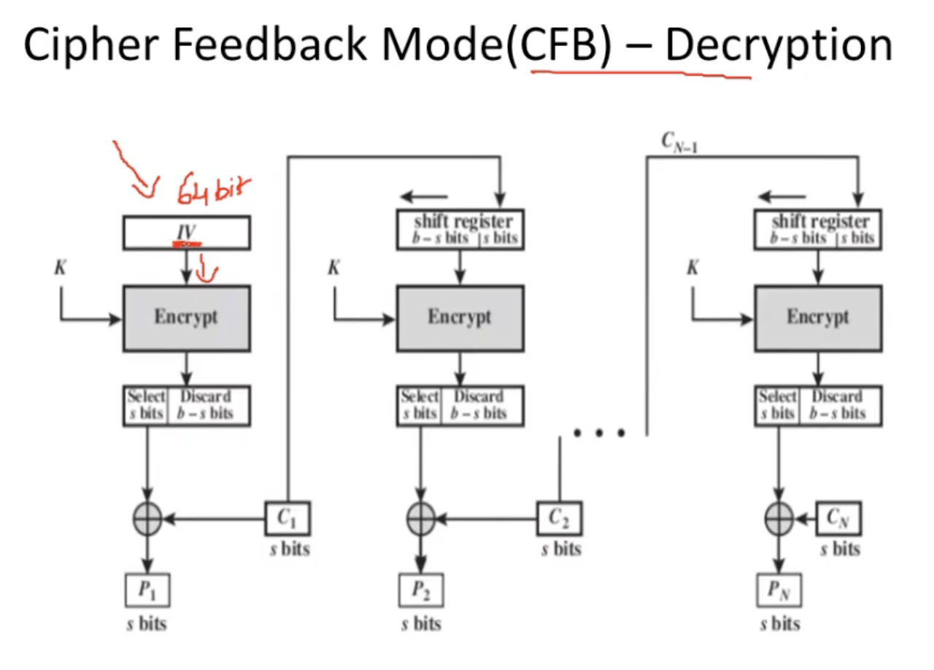

Slide 40
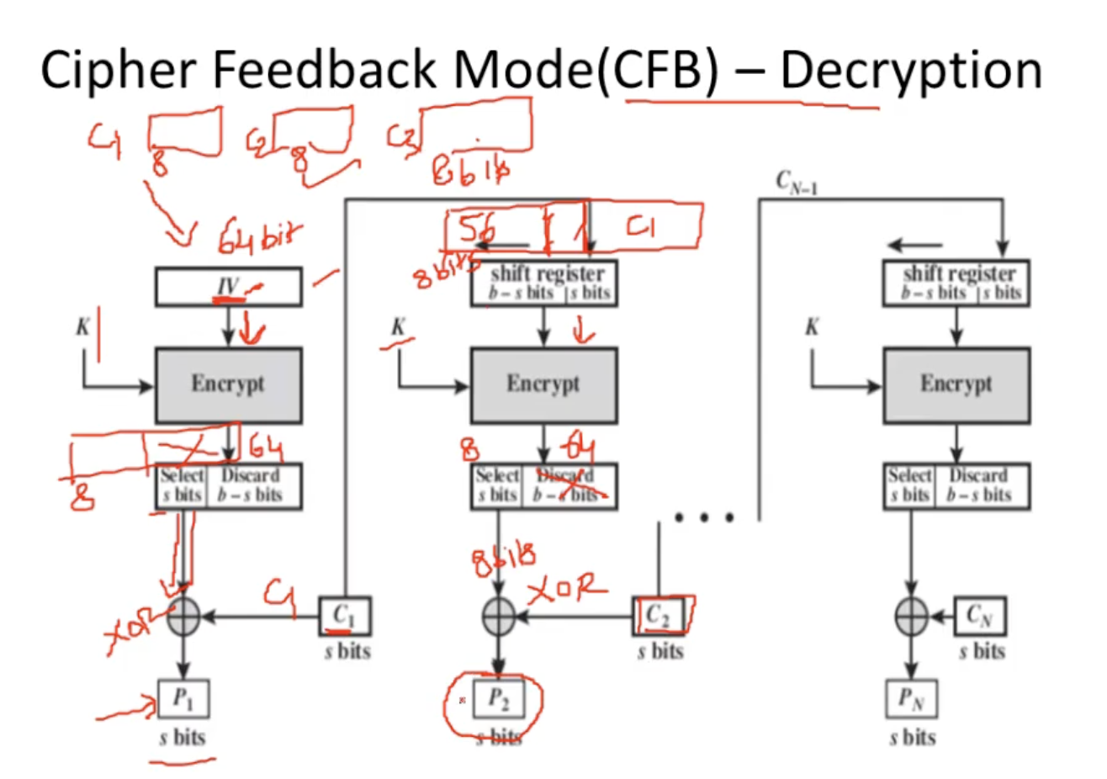

Slide 41
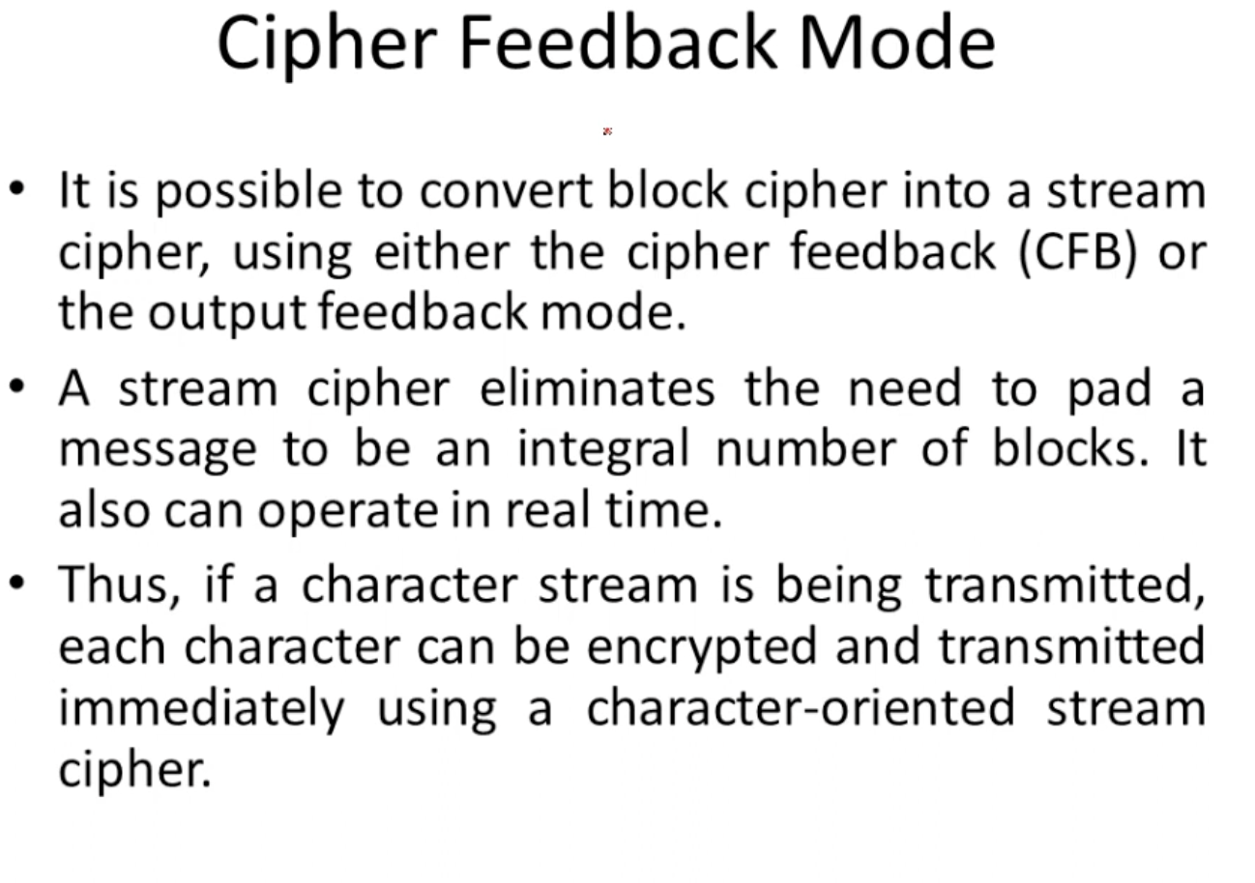

Slide 42
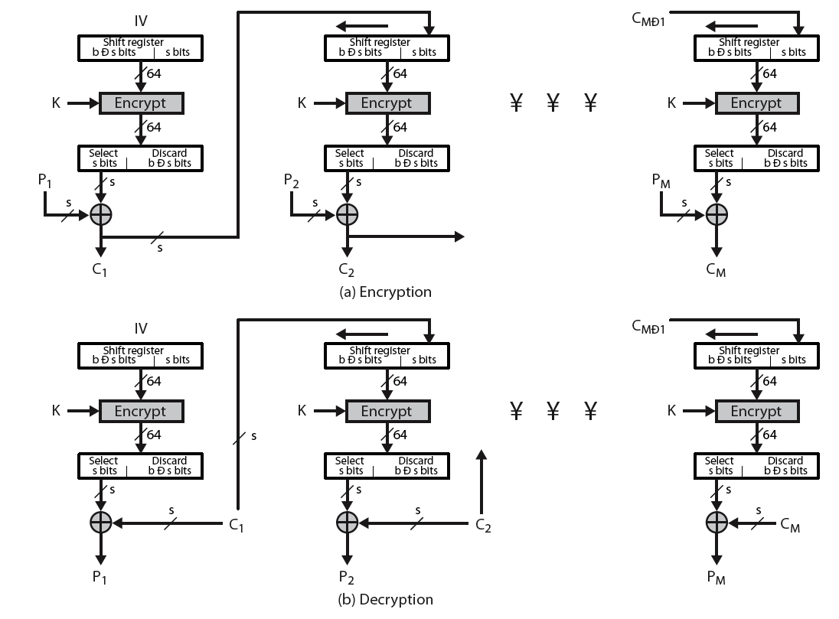
Cipher Feedback (CFB)
Notes:
Stallings Figure 6.5 illustrates the Cipher FeedBack (CFB) Mode.

Slide 43
5. Output Feedback (OFB)
Message is treated as a stream of bits
Output of cipher is added to message
Output is then feedback
Feedback is independent of message
Can be computed in advance
  C_{i} = P_{i} XOR O_{i}
  O_{i} = DES_{K1}(O_{i-1})
  O₋₁ = IV
Notes:
The alternative to CFB is OFB. Here the generation of the "random" bits is independent of the message being encrypted. The advantage is that firstly, they can be computed in advance, good for bursty traffic, and secondly, any bit error only affects a single bit. Thus this is good for noisy links (eg satellite TV transmissions etc).

Slide 44
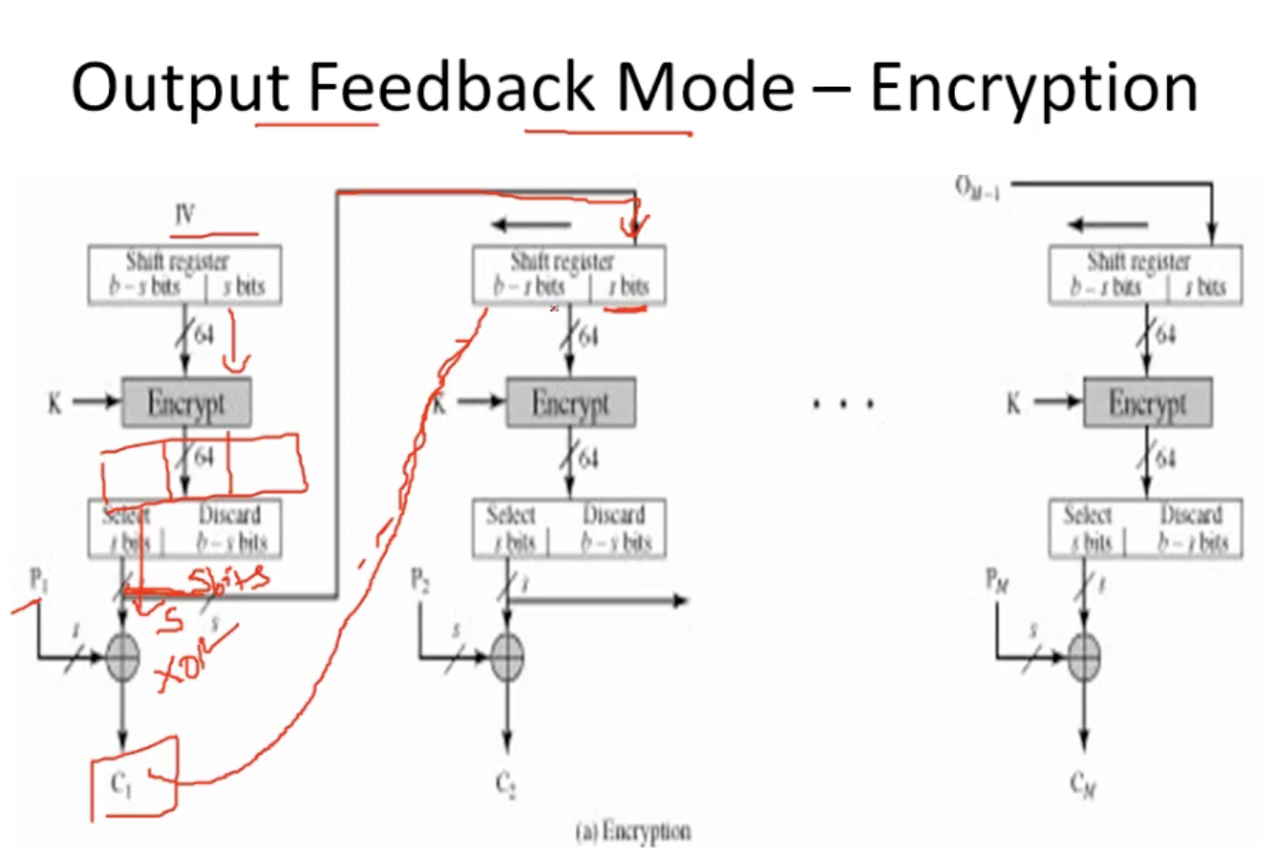

Slide 45
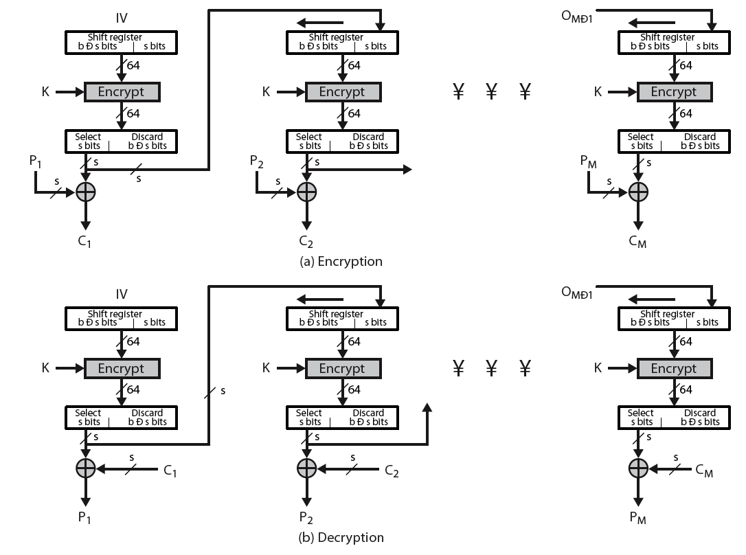
Output Feedback (OFB)
Notes:
Stallings Figure 6.6 illustrates the Output FeedBack (OFB) Mode.

Slide 46
Advantages and Limitations of OFB
Bit errors do not propagate
More vulnerable to message stream modification
Variation of a Vernam cipher
  hence must never reuse the same sequence (key+IV)
Sender & receiver must remain in sync
Originally specified with m-bit feedback
Subsequent research has shown that only full block feedback (ie CFB-64 or CFB-128) should ever be used
Notes:
One advantage of the OFB method is that bit errors in transmission do not propagate. The disadvantage of OFB is that it is more vulnerable to a message stream modification attack than is CFB.
Since OFB is a Vernam cipher variant, the stream should never be used more than once (otherwise the 2 ciphertexts can be combined, cancelling these bits, and leaving a "book" cipher to solve). And sender & receiver need to remain in sync, or all data is lost. Also, research has shown that you should only ever use a full block feedback ie OFB-64/128 mode.

Slide 47
Stream Ciphers
Process message bit by bit (as a stream)
Have a pseudo random keystream
Combined (XOR) with plaintext bit by bit
Randomness of stream key completely destroys statistically properties in message
  C_{i} = M_{i} XOR StreamKey_{i}
But must never reuse stream key
  otherwise can recover messages
Notes:
A typical stream cipher encrypts plaintext one byte (or bit) at a time, usually by XOR’ing with a pseudo-random keystream. The stream cipher is similar to the one-time pad discussed in Chapter 2. The difference is that a one-time pad uses a genuine random number stream, whereas a stream cipher uses a pseudorandom number stream. But rely on the randomness of stream key completely destroys statistically properties in message. However, you must never reuse a stream key since otherwise you can recover messages (as with a book cipher).

Slide 48

Stream Cipher Structure
Notes:
Stallings Figure 6.8 illustrates the general structure of a stream cipher, where a key is input to a pseudorandom bit generator that produces an apparently random keystream of bits, and which are XOR’d with message to encrypt it, and XOR’d again to decrypt it by the receiver.

Slide 49
Stream Cipher Properties
Some design considerations are:
  long period with no repetitions
  statistically random
  depends on large enough key
  large linear complexity
Properly designed, can be as secure as a block cipher with same size key
But usually simpler & faster
Notes:
[KUMA97] lists the following important design considerations for a stream cipher:
The encryption sequence should have a large period, the longer the period of repeat the more difficult it will be to do cryptanalysis.
The keystream should approximate the properties of a true random number stream as close as possible, the more random-appearing the keystream is, the more randomized the ciphertext is, making cryptanalysis more difficult.
To guard against brute-force attacks, the key needs to be sufficiently long. The same considerations as apply for block ciphers are valid here .Thus, with current technology, a key length of at least 128 bits is desirable.
With a properly designed pseudorandom number generator, a stream cipher can be as secure as block cipher of comparable key length. The primary advantage of a stream cipher is that stream ciphers are almost always faster and use far less code than do block ciphers.

Slide 50
RC4
Proprietary cipher owned by RSA DSI
Another Ron Rivest design, simple but effective
Variable key size, byte-oriented stream cipher
Widely used (web SSL/TLS, wireless WEP)
Key forms random permutation of all 8-bit values
Uses that permutation to scramble input info processed a byte at a time
Notes:
RC4 is a stream cipher designed in 1987 by Ron Rivest for RSA Security. It is a variable key-size stream cipher with byte-oriented operations. The algorithm is based on the use of a random permutation. Analysis shows that the period of the cipher is overwhelmingly likely to be greater than 10^100. Eight to sixteen machine operations are required per output byte, and the cipher can be expected to run very quickly in software. RC4 is probably the most widely used stream cipher. It is used in the SSL/TLS secure web protocol, & in the WEP & WPA wireless LAN security protocols. RC4 was kept as a trade secret by RSA Security, but in September 1994 was anonymously posted on the Internet on the Cypherpunks anonymous remailers list. In brief, the RC4 key is ued to form a random permutation of all 8-bit values, it then uses that permutation to scramble input info processed a byte at a time.

Slide 51
RC4 Key Schedule
Starts with an array S of numbers: 0..255
Use key to well and truly shuffle
S forms internal state of the cipher
  for i = 0 to 255 do
    S[i] = i
    T[i] = K[i mod keylen])
  j = 0
  for i = 0 to 255 do
    j = (j + S[i] + T[i]) (mod 256)
    swap (S[i], S[j])
Notes:
The RC4 key schedule initialises the state S to the numbers 0..255, and then walks through each entry in turn, using its current value plus the next byte of key to pick another entry in the array, and swaps their values over. After doing this 256 times, the result is a well and truly shuffled array. The total number of possible states is 256! - a truly enormous number, much larger even than the 2048-bit (256*8) max key allowed can select.

Slide 52
RC4 Encryption
Encryption continues shuffling array values
Sum of shuffled pair selects "stream key" value from permutation
XOR S[t] with next byte of message to en/decrypt
  i = j = 0
  for each message byte M_{i}
    i = (i + 1) (mod 256)
    j = (j + S[i]) (mod 256)
    swap(S[i], S[j])
    t = (S[i] + S[j]) (mod 256)
    C_{i} = M_{i} XOR S[t]
Notes:
To form the stream key for en/decryption (which are identical), RC4 continues to shuffle the permutation array S by continuing to swap each element in turn with some other entry, and using the sum of these two entry values to select another value from the permutation to use as the stream key, which is then XOR’d with the current message byte.

Slide 53
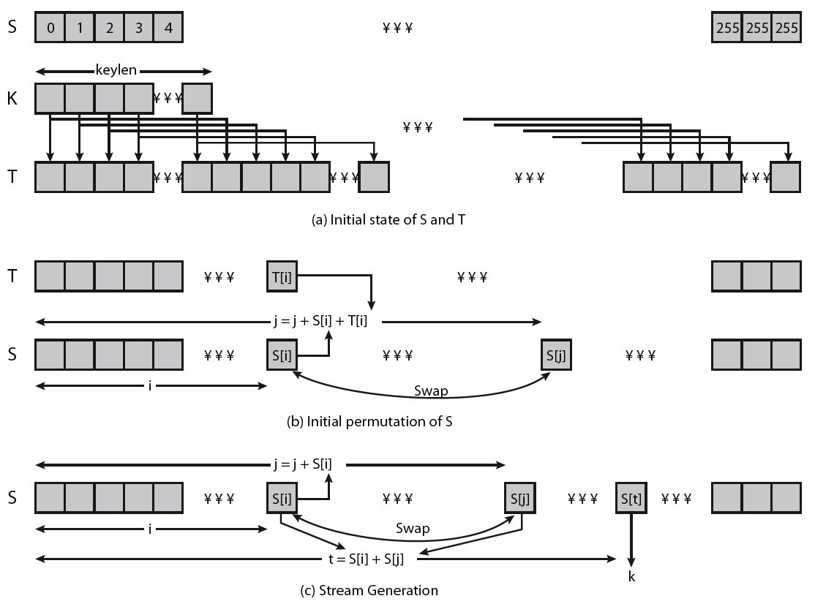
RC4 Overview
Notes:
Stallings Figure 6.9 illustrates the general structure of RC4.

Slide 54
RC4 Security
Claimed secure against known attacks
  have some analyses, none practical
Result is very non-linear
Since RC4 is a stream cipher, must never reuse a key
Notes:
A number of papers have been published analyzing methods of attacking RC4, but none of these approaches is practical against RC4 with a reasonable key length, such as 128 bits.
A more serious problem occurs in its use in the WEP protocol, not with RC4 itself but the way in which keys are generated for use as input to RC4.
Currently RC4 its regarded as quite secure, if used correctly, with a sufficiently large key.

